Slide 1
JOIN
Fundamentals of Database Systems

Slide 2
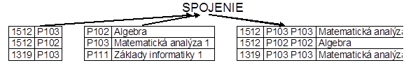
Example

Slide 3
Definícia – Join
Operácia JOIN (spojenie) vytvorí
z relácie R1(X, A1,A2, …, An) a
z relácie R2(X,B1,B2,…,Bm), ktoré majú spoločnú množinu atribútov X tretiu reláciu R3(X,A1,A2,…,An, X,B1,B2,…,Bm) takú,
že ak t1 ϵ R1 a ak t2 ϵ R2 a pre hodnoty atribútov X platí t1.X=t2.X,
potom n-tica t ϵ R3 má atribúty
t= t1..X , t1..A1 , t1..A2 , …, t1..An , t2..X , t2..B1, t2..B2, …, t2..Bm.

Slide 4
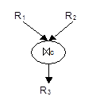
Označenie
a) grafické
b) matematické
R3 = R1 c R2
R3 = R1 JOINC R2
R3 = JOIN (R1,R2,C)
Page <number>

Slide 5
Basic JOIN
SELECT ...
FROM list of tables
WHERE conditions for connection;

Slide 6
Operáciu relačnej algebry spojenie je možné vyjadriť pomocou operácií kartézsky súčin a výber. V tom prípade pre spojenie R platí:
R₃ = σ_{C}(R₁×R₂)
Strana <number>

Slide 7
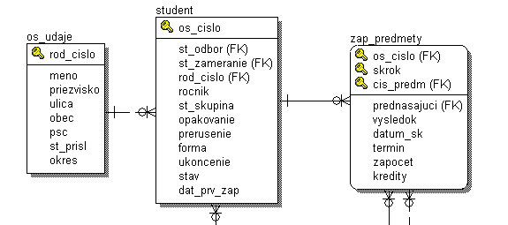
List of student with results
SELECT meno, priezvisko
FROM os_udaje
, cis_predm, vysledok
, zap_predmety
, student
WHERE os_udaje.rod_cislo = student.rod_cislo
and student.os_cislo = zap_predmety.os_cislo

Slide 8
SELECT meno, priezvisko, cis_predm, vysledok
FROM os_udaje ou, student st, zap_predmety zp
WHERE ou.rod_cislo = st.rod_cislo
AND st.os_cislo = zp.os_cislo
SELECT meno, priezvisko, cis_predm, vysledok
FROM os_udaje JOIN student USING (rod_cislo)
JOIN zap_predmety USING (os_cislo)
… must be with the same name in joining tables
SELECT meno, priezvisko, cis_predm, vysledok
FROM os_udaje ou JOIN student st
ON (ou.rod_cislo = st.rod_cislo)
JOIN zap_predmety zp
ON (st.os_cislo = zp.os_cislo)
… always possible

Slide 9
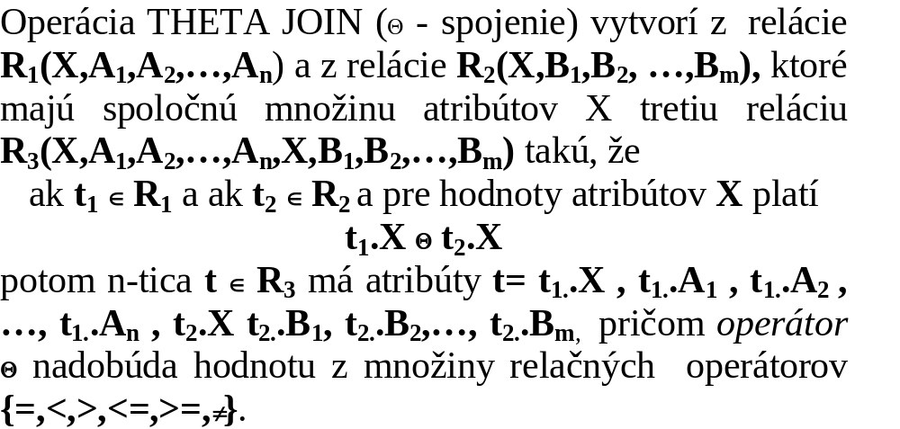
THETA JOIN

Slide 10
Ďalšie varianty operácie spojenia
V literatúre sa môžeme stretnúť s ďalšími operáciami relačnej algebry, ktoré sú rozšírením základných operácií relačnej algebry a sú to:
a) prirodzené spojenie
b) theta spojenie
c) equi spojenie
d) inequi spojenie
e) externé spojenie
f) polospojenie (semi spojenie)

Slide 11
Syntax (ANSI )
SELECT ...
FROM ...,tabulka1 [NATURAL] JOIN_TYPE JOIN tabulka2
{ |ON (podmienka_spojenia)| USING (zoznam_stlpcov)}, ...
[WHERE ...]

Slide 12
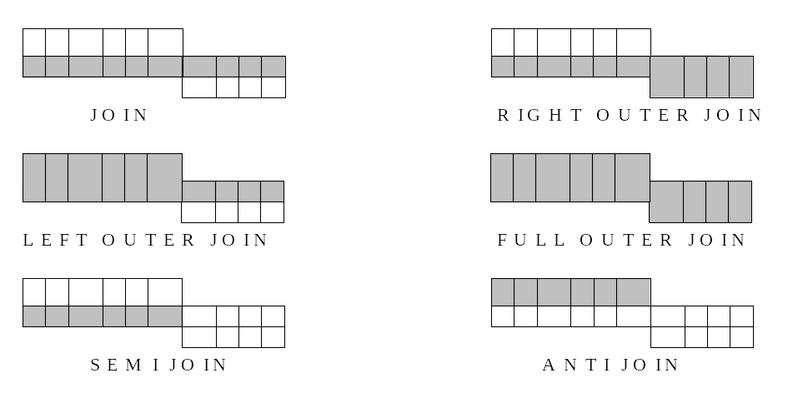
Kinds of joins

Slide 13
Join_Type
INNER – internal join i.e. only joined rows . This kind of join is DEFAULT.
RIGHT [OUTER]- right external join i.e. result will have connected rows and rows from right table if join was not realized.
LEFT [OUTER]- left external join i.e. result will have connected rows and rows from left table if join was not realized.
FULL [OUTER] – complete external join i.e. result will have connected rows and rows from right table if join was not realized and rows from left table if join was not realized.
NATURAL – in this case is not possible use ON (condition), or USING clause, because the join will be done under the equivalent name column in joining tables.Referencing integrity is not checking.
USING (list of columns)– if we use USING, then is not possible use NATURAL either ON (condition) clause. List of columns must exists in both tables. Referencing integrity is not checking.

Slide 14
Steps for complicated tasks with join
We want to create List of students (name, surname) who studied Course A602

Slide 15
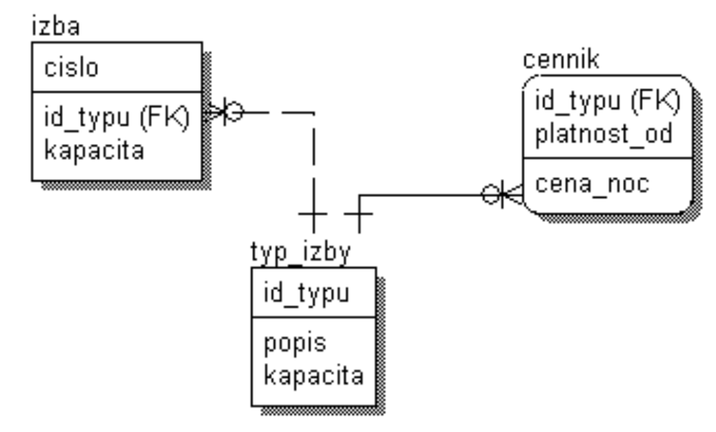
ODD join
Select cena_noc
from izba i, typ_izby t, cennik c
where i.id_typu = t.id_typu
and t.id_typu = c.id_typu
and i.cislo = 212
and c.platnost_od = '1.6.2006';

Slide 16
More Simple Notation
Select cena_noc
from izba i, cennik c
where i.id_typu = c.id_typu
and i.cislo = 212
and c.platnost_od = '1.6.2006';

Slide 17
JOIN
SELECT meno, priezvisko, popis, kontakt
FROM os_udaje ou, kontakty kont
WHERE ou.rod_cislo = kont.rod_cislo
SELECT meno, priezvisko, popis, kontakt
FROM os_udaje ou INNER JOIN kontakty kont
ON (ou.rod_cislo = kont.rod_cislo);
-- len ak atributy spojenia maju rovnake meno
–- zle ak aj ine atributy maju rovnake meno, nielen atributy spojenia
SELECT meno, priezvisko, popis, kontakt
FROM os_udaje ou NATURAL JOIN kontakty kont;
-- len ak atributy spojenia maju rovnake meno
SELECT meno, priezvisko, popis, kontakt
FROM os_udaje ou JOIN kontakty kont USING (rod_cislo);

Slide 18
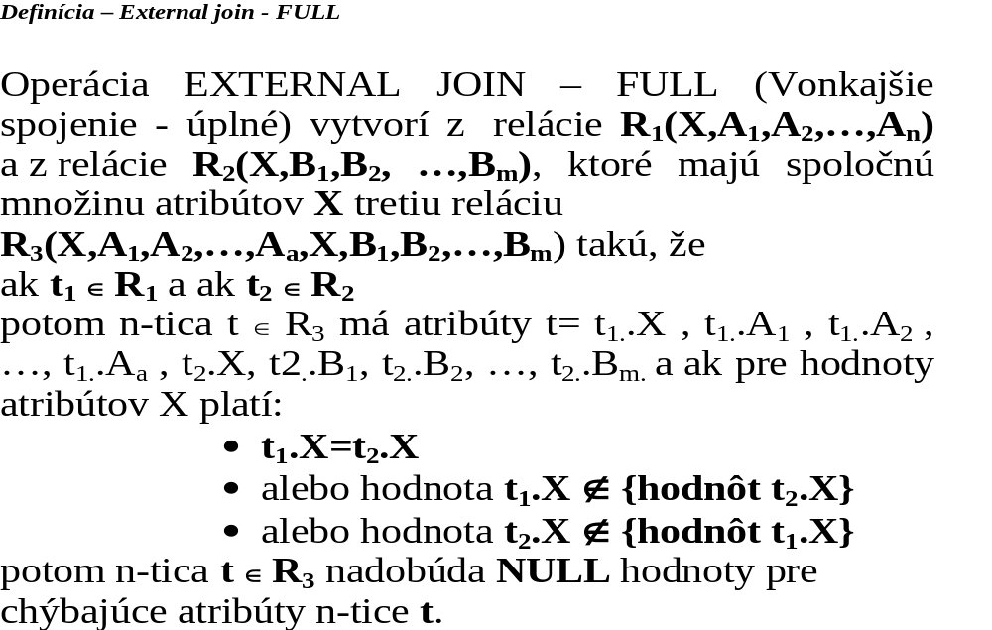

Slide 19
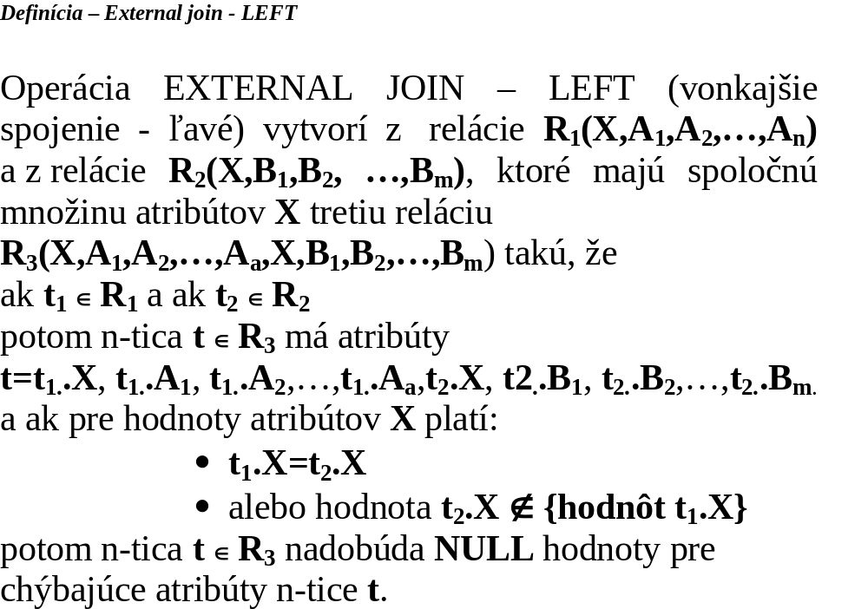

Slide 20
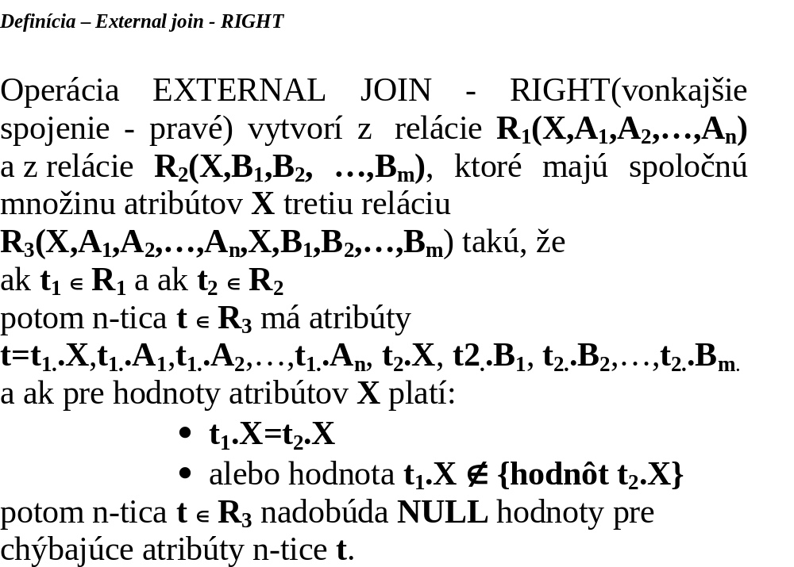

Slide 21
LEFT OUTER JOIN
SELECT meno, priezvisko, popis, kontakt
FROM os_udaje ou LEFT OUTER JOIN kontakty kont
ON (ou.rod_cislo = kont.rod_cislo)
ORDER BY priezvisko;
–- slovo "outer" je mozne vynechat

Slide 22
LEFT OUTER JOIN
SELECT meno, priezvisko, popis, kontakt
FROM os_udaje ou LEFT JOIN kontakty kont
ON (ou.rod_cislo = kont.rod_cislo)
ORDER BY priezvisko;

Slide 23
MENO | PRIEZVISKO | POPIS | KONTAKT
Branislav | Balaz
Bohuslav | Biely
Marek | Durica
Andrej | Janci
Peter | Kapustny | email | kapo@post.sk
Martin | Kluciar
Rastislav | Kontros
Rudolf | Kovac
Jan | Krnac
Lubos | Lehotsky
Erika | Lipovska
Frantisek | Murgas
Peter | Novak | telef | 041/5698574
Peter | Novak | email | Peter.Novak@st.fri.utc.sk
Juraj | Papun
Marek | Ratroch | telef | 07/5561174
Lukas | Satrapa | email | lsatra@post.sk
Lukas | Satrapa | mobil | 0915 1234222
Zuzana | Slamova
Stanislav | Steinmuller
Zdeno | Svetkovsky
Janos | Toth

Slide 24
RIGHT OUTER JOIN
SELECT meno, priezvisko, popis, kontakt
FROM os_udaje ou RIGHT OUTER JOIN kontakty kont
ON (ou.rod_cislo = kont.rod_cislo)
ORDER BY priezvisko;

Slide 25
RIGHT OUTER JOIN
SELECT meno, priezvisko, popis,kontakt
FROM kontakty kont RIGHT OUTER JOIN os_udaje ou
ON (ou.rod_cislo = kont.rod_cislo)
ORDER BY priezvisko;

Slide 26
RIGHT OUTER JOIN
SELECT meno, priezvisko, popis,kontakt
FROM kontakty kont NATURAL RIGHT OUTER JOIN os_udaje ou
ORDER BY priezvisko;

Slide 27
RIGHT OUTER JOIN
SELECT meno, priezvisko, popis,kontakt
FROM kontakty kont RIGHT OUTER JOIN os_udaje ou USING (rod_cislo)
ORDER BY priezvisko;

Slide 28
OUTER JOIN
-- older syntax
SELECT meno, priezvisko, popis,kontakt
FROM kontakty kont, os_udaje ou
WHERE ou.rod_cislo (+) = kont.rod_cislo
ORDER BY priezvisko;

Slide 29
OUTER JOIN
-- older syntax
SELECT meno, priezvisko, popis,kontakt
FROM kontakty kont, os_udaje ou
WHERE ou.rod_cislo = kont.rod_cislo (+)
ORDER BY priezvisko;

Slide 30
FULL OUTER JOIN
SELECT meno, priezvisko, popis,kontakt
FROM kontakty kont FULL OUTER JOIN os_udaje ou
ON ( ou.rod_cislo = kont.rod_cislo )
ORDER BY priezvisko;

Slide 31
FULL OUTER JOIN
SELECT meno, priezvisko, popis,kontakt
FROM kontakty kont NATURAL FULL OUTER JOIN os_udaje ou
ORDER BY priezvisko;

Slide 32
FULL OUTER JOIN
FROM kontakty kont FULL OUTER JOIN os_udaje ou USING (rod_cislo)
ORDER by priezvisko;
–-

Slide 33
FULL OUTER JOIN
–- pomocou starej syntaxe to bolo mozne len cez UNION dvoch selectov
SELECT meno, priezvisko, popis,kontakt
FROM kontakty kont, os_udaje ou
WHERE kont.rod_cislo (+) = ou.rod_cislo
UNION
SELECT meno, priezvisko, popis,kontakt
FROM kontakty kont, os_udaje ou
WHERE kont.rod_cislo = ou.rod_cislo(+)
ORDER BY priezvisko;

Slide 34
SEMI JOIN
SELECT ou.*
FROM os_udaje ou
WHERE EXISTS( SELECT 'x'
FROM kontakty kont
WHERE kont.rod_cislo = ou.rod_cislo);

Slide 35
ANTI JOIN
SELECT ou.*
FROM os_udaje ou
WHERE NOT EXISTS( SELECT 'x'
FROM kontakty kont
WHERE kont.rod_cislo = ou.rod_cislo);

Slide 36


UNIVERSITY OF ZILINA
FACULTY OF MANAGEMENT SCIENCE AND INFORMATICS
DEPARTMENT OF INFORMATICS
Univerzitna 8215/1SK-01026, Zilina, Slovak Republic
Phone: +421-41-513 4040
Fax: +421-41-513 4055
Homepage: http://www.fri.uniza.sk
Introduction
The Department of Informatics comprises around 20 academics and research fellows who form research community in Computer Science. Its complement of people directly involved in research is close to 50. The Department is strongly involved in many practical collaborative industry projects and research projects on national and international level.
Research
Research addresses the fundamentals of computer systems, architectures, database systems and information analysis. The key research topics cover distributed and parallel systems and advanced database systems.
prof. Ing. Karol Matiaško, PhD.
Karol.matiasko@fri.uniza.sk
Department of Informatics
Faculty of Management Science and Informatics
University of Zilina
Strana <number>

